Slide 1
Project “DAK”
DAK: “Does AI Know”?
Scope: Create DAK app to perform predictions for various scenarios by utilising machine learning algorithms, python libraries with front end UI and host on a cloud platform with public access
Team Members:
Daniela Cornea (DC)
Anh Huong (AH)
Kevin Nguyen (KN)
Project repo: https://github.com/DCornea5/Final-Project.git

Slide 2
Methods
Methods: Flask API, HTML/CSS/Boostrap, Matplotlib, Tableau, Heroku, github, etc…
Dataset:
heart_disease.csv
Stress-Lysis.csv
bodyPerformance.csv
TravelInsurancePredictions.csv
Absenteeism_at_work2.csv
Sources:
Kaggle, https://www.kaggle.com/code/ahmedklabi/heart-disease-pred/data
Dataworld, https://data.world/aaizemberg/absenteeismatwork/workspace/file?filename=Absenteeism_at_work.tsv

Slide 3
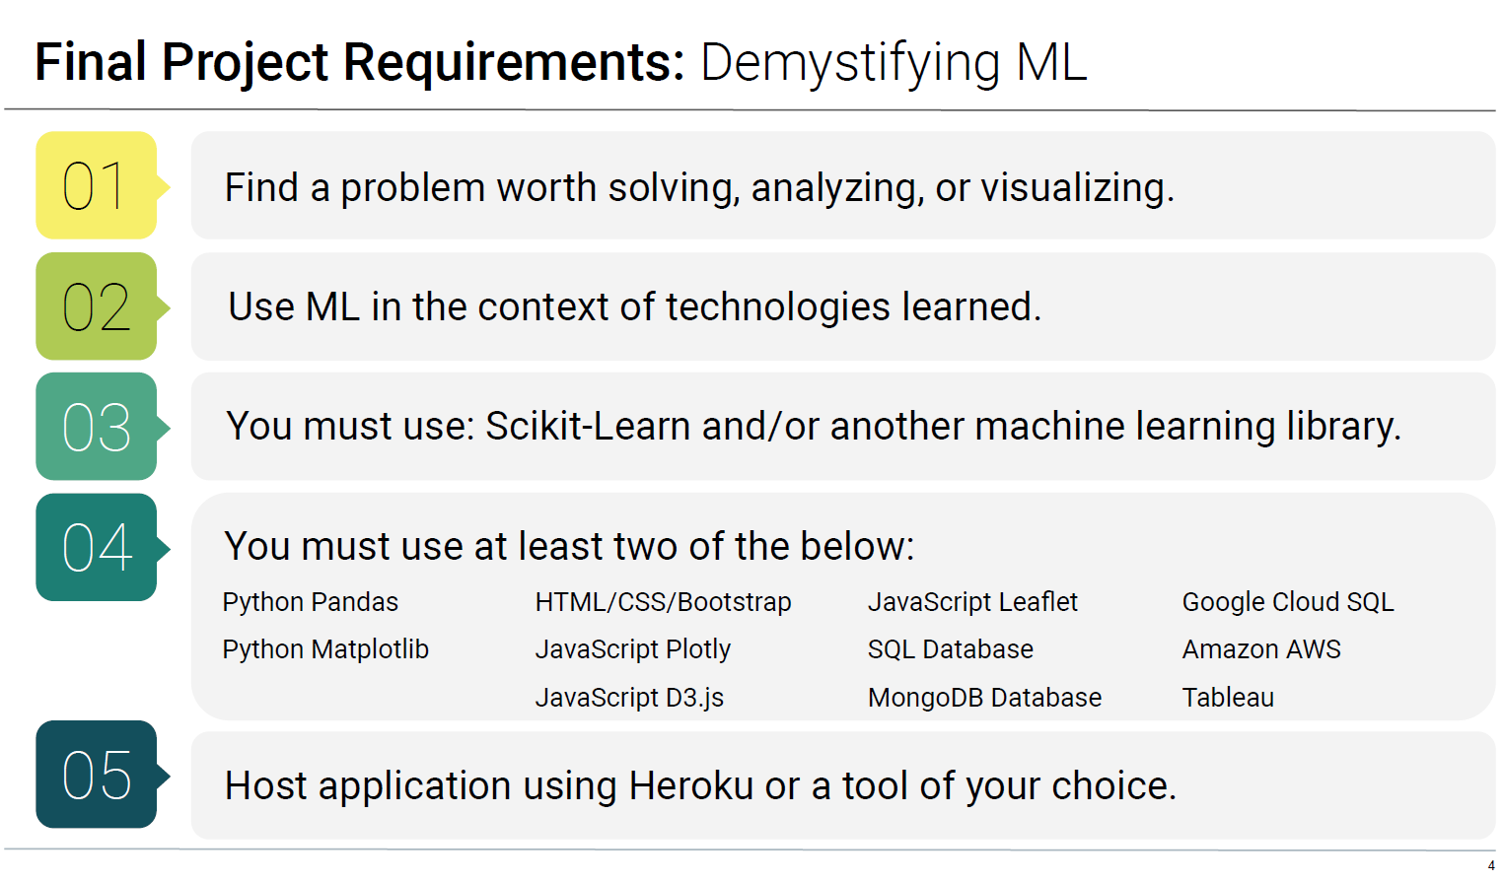
Project High Level Requirements

Slide 4





High Level Design
Data
User Interface
EDA/ Pre-processing
Option1
Option2
Option3
OptionN
Algorithm
Predictor
ML Models
Mod_1
Mod_N

Slide 5
Project Plan
Research project topic and select datasets on various sources
Create project plan and github repo
Project is adopting Agile methodology for software development:
Iterations of design, coding, testing for the app’s front and back-end.
Minimum viable product (MVP): a working machine learning model (ML) with user interface (UI) front end that hosted on a cloud platform
Product: a completed a scalable front end web site with various ML models that hosted on a cloud platform.
On-going task allocations: self-manage, support other team members as required
Project presentation
Documentations:
Project docs, reports
Presentation pack

Slide 6
Project Schedules & Milestones
Date | Task # | Descriptions | Status
8/4 | 0 | Form the project team | Completed
10/4 18/4 | 1 | Select project topic Select datasets on various open sources ML models - perform exploratory data analysis(EDA), build, test, measure and save the models: Stroke prediction Body performance prediction Stress level prediction Travel Insurance prediction Polygon shape prediction (WIP) | Completed
19/4 | 2 | High level design Present project proposal to instructors
20/4 | 3 | Front-end web site design
30/4 | 4 | Completed web-site design
1/5 | 5 | Finalise platform deployment End-to-end test
2/5 | 6 | Presentation rehearsal
3/5 | 7 | Project presentation Project submission

Slide 7
Challenges
Performed Exploratory Data Analysis (EDA) on datasets
Zomato Restaurant Reviews.
Outcome: Unable to utilise on the project as the data is heavily skewed for the restaurants in India
Absenteeism at work.
Outcome: Applied 12 different ML methods, 17 out of 21 columns are seemed relevant. Not user friendly as too many fields are required user input
etc…adfafd
Etc…

